Slide 1


Global Gate Health Care
NCLEX Program
Empowering Palestinian Nurses for U.S. Practice
WHO WE ARE?

Slide 2
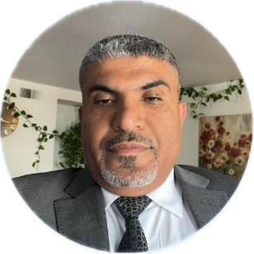
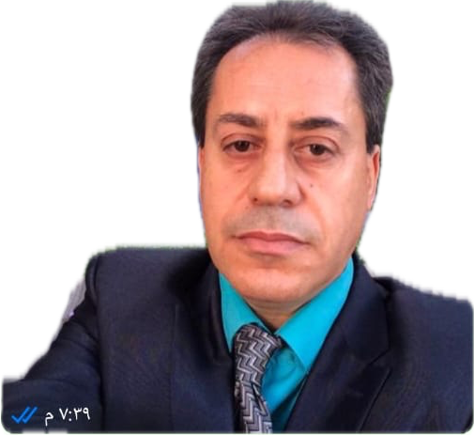
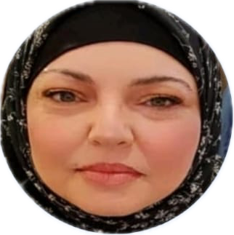
Our Professional Guidance Network
Our program features experienced Palestinian-American healthcare professionals who provide personalized guidance throughout the journey from preparation to U.S. practice.
Mr. Hesham Alsayyad, MSN, MBA, CPHQ, VA-BC, PMP
Dr. Fidaa Abu Ali, PhD, MPH, SON, BSN
Clinical expertise, Academic leadership, Digital innovation – Nablus, Palestine
PhD in the Philosophy of Nursing, Experienced nursing and public health professional, an MPH, and a BScN. Skilled in clinical care, academic leadership, project management, and digital education. Proven impact across Palestine’s healthcare and higher education sectors.
Dr. Awni Dweekat, DNP, MSN, BSN, RN, CCRN
Lead NCLEX Instructor – California, USA
Cultural Transition and NCLEX Instructor – Ramallah, Palestine
Board-certified healthcare leader and NCLEX instructor with over 15 years of clinical and administrative experience. Specialized in international nurse training, U.S. healthcare system integration, and patient-centered care. Demonstrated success in leading workforce development initiatives, driving quality improvement, and implementing strategic clinical education programs that enhance both care delivery and operational excellence
Doctor of Nursing Practice (EBP) Critical Care. Palestinian-American nurse with 20+ years experience in both healthcare systems. Provides cultural orientation, professional development, and personal support to help nurses adapt to U.S. healthcare environments and workplace culture. NCLEX orientation and instructor, background with critical
.
e
Cultural Transition and NCLEX Instructor – Ramallah, Palestine
Notes:
PhD (Doctor of Philosophy). MBA (Master of Business Administration). BSC (Bachelor of Science). HND (Higher National Diploma. MSN (Master of Science in Nursing). MBA (Master of Business Administration). CPHQ (Certified Professional in Healthcare Quality) . VA-BC (Vascular Access Board Certified). PMP (Project Management Professional). DNP (Doctor of Nursing Practice). BSN (Bachelor of Science in Nursing). RN (Registered Nurse). CCRN (Critical Care Registered Nurse). MD (Medical Doctor). AP (Advanced Practice). MPH (Master of Public Health). SON (School of Nursing). EBP (Evidence Based Practice).

Slide 3



Mission & Vision
To create sustainable pathways for qualified Palestinian nurses to build rewarding careers in the United States healthcare system while addressing critical nursing shortages and fostering cross-cultural healthcare excellence.
To empower Overseas Palestinian Nurses (OPN) by enhancing the affordability, security, and impact of their remittances, while fostering long-term economic development for Palestinian communities.
Our Mission
Our Vision
A world where healthcare talent flows freely across borders, creating opportunities for Palestinian nurses while strengthening the U.S. healthcare system through diversity, cultural competence, and professional excellence.

Slide 4
Market Problem
Palestinian Nurse Market
U.S. Nursing Market
The Challenge
The Challenge
Limited career advancement opportunities in local healthcare system
Critical nursing shortage projected to reach 1.1 million by 2030
Significant wage gap compared to international markets
Aging nursing workforce with 1/3 nearing retirement age
Political instability affecting healthcare infrastructure
Increasing healthcare demands from aging U.S. population
High unemployment rate among qualified nursing graduates
Nursing schools unable to meet demand for new graduates
Complex barriers to international employment opportunities
High turnover rates and burnout among existing nursing staff
Notes:
The average age of registered nurses (RNs) in the United States is approximately 43.4 years, Over 600,000 RNs expected to retire by 2030. Health Resources and Services Administration (HRSA, 2024). Bureau of Health Workforce
As of 2024, approximately 101,000 people in the United States are aged 100 or older, reaching around 422,000 by 2054.

Slide 5

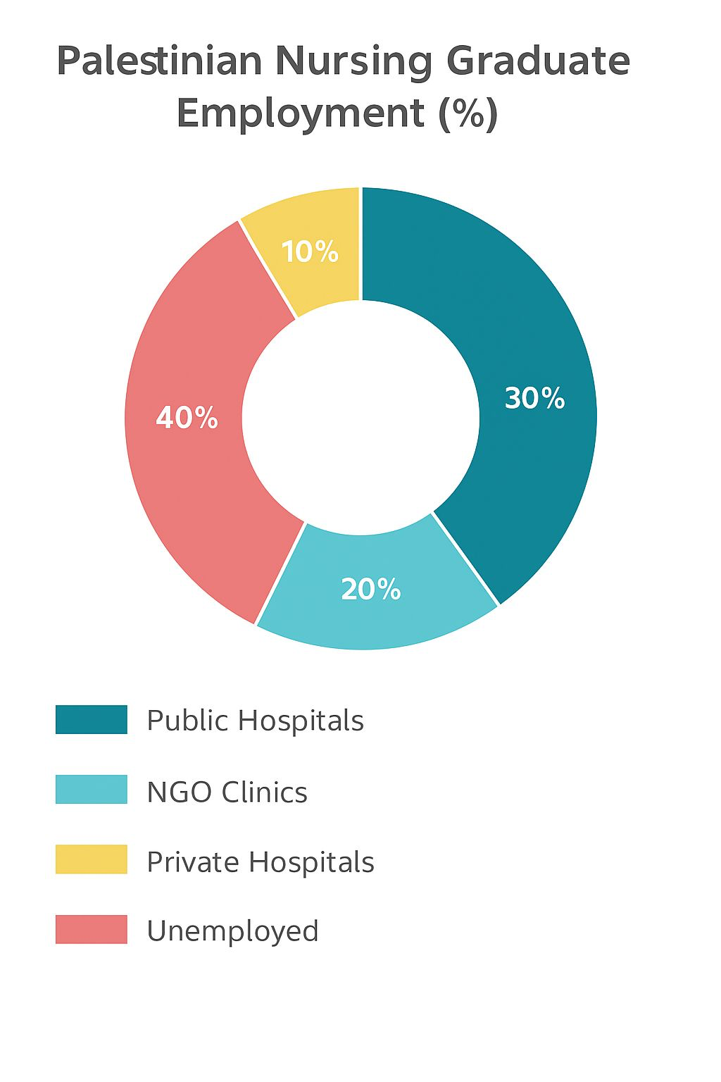
Palestinian Nurse Market
40%
Unemployment Rate Among Recent Nursing Graduates
Market Overview
Employment/Unemployment Breakdown
Palestinian nursing education produces 2000+ graduates annually
Local healthcare system can only absorb 40% of new graduates
Average nurse salary: $800-1,200/mont
A nationwide WHO‑led survey across the West Bank (including East Jerusalem) and Gaza Strip reports over 25,211 nurses in total
Active–Employed 14,593 out of 25,211
85%
Nurses Interested in International Opportunities
Notes:
Palestinian Central Bureau of statistics (PCBS) Labour‑Force Survey, 2021.
pmc.ncbi.nlm.nih.gov/articles

Slide 6

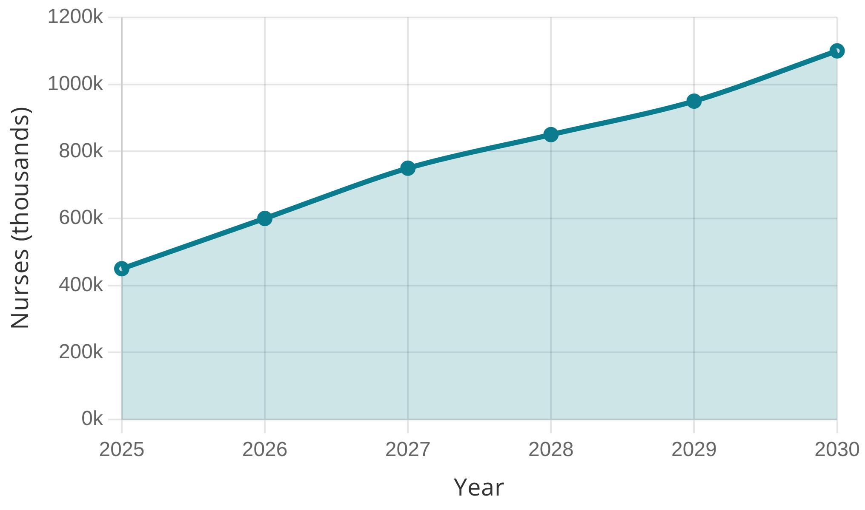
U.S. Nursing Market
1.1M+
Market Overview
$80,000
Projected Nurse Shortage by 2030
Average Starting Salary
The U.S. nursing market faces a critical shortage that continues to grow annually, creating significant opportunities for qualified international nurses.
15%
33%
Projected shortage of 1.1 million nurses by 2030
International Nurse Workforce
Nurses Nearing Retirement
Average annual salary: $80,000 - $120,000+
U.S. Nursing Shortage Projection (2025-2030)
There were approximately 22 million healthcare workers in the USA, among them 4.7 million RN’S (CDC, AACN, 2025)
International nurses make up about15% of the nursing workforce

Slide 7
Our Solution
We propose the establishment of ( Global Gate Health Care )
This venture aims: 🎯
To bridge the critical healthcare staffing gap in the U.S. by providing highly trained nurses. ⁠🔗
To empower overseas Palestinian nurses (OPN) to enhance economic development for Palestinian communities. ⁠💰

Slide 8





Strategic Collaborations
Academic Partnership:
1- Palestinian nursing council - Palestine
2- Bier Ziet University – Palestine
3- UWarld (Technology partner) – USA
Healthcare Partner : 1- WWSS (Westways Staffing Services) – USA:
. Healthcare Employment Network
. U.S. State Department (Government relation)
Global gate in collaboration with Bier Ziet university proposes the development and delivery of missing or insufficient coursework to address curriculum gaps identified by the U.S. state boards of nursing
Notes:
Westways Staffing Services, Inc. is a nurse-owned healthcare staffing agency founded in 1992 by Harold Sterling, R.N., who serves as the company's CEO. With over 30 years of experience, Westways specializes in per diem and travel nursing, as well as staffing for cardiac catheterization labs, allied healthcare, and pharmacy roles across the United States. For more information visit their official website: westwaysstaffing.com.

Slide 9



Strategic Collaborations
Continue …
Our program is strengthened by strategic partnerships across healthcare, education, and government sectors, creating a robust ecosystem to support Palestinian nurses' transition to U.S. practice.
Healthcare Partners
Educational Partners
Government Relations
American Hospital Association
Palestinian Nursing Council
U.S. State Department
Healthcare Employment Network
Credential Verification
Healthcare Workforce Initiative
Provides direct placement opportunities at hospitals across the United States.
Through WWSS
Facilitates credential verification and ensures educational standards alignment.
Special visa pathway program for healthcare professionals.
Through WWSS
Technology Partners
UWarld
Digital Learning Platform
Provides customized e-learning platform with NCLEX simulation technology.

Slide 10


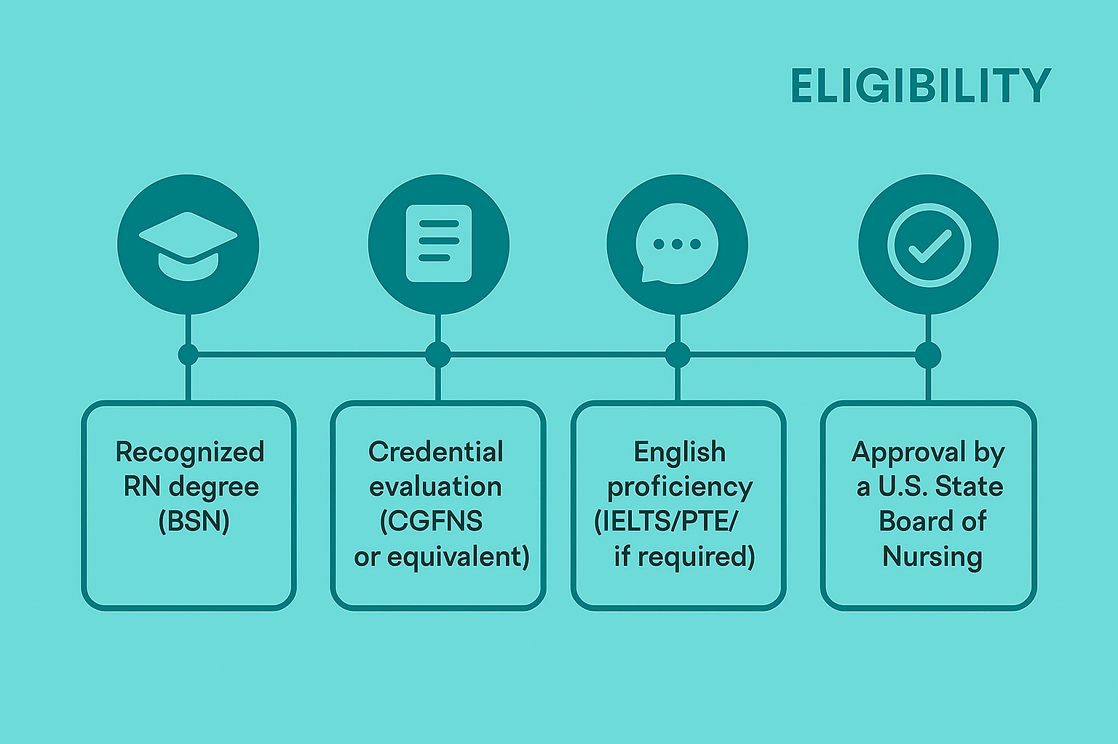
Our Solution: NCLEX Program
The Global Gate NCLEX Program bridges the gap between Palestinian nursing talent and U.S. healthcare needs through a structured, supportive pathway to success.
What is NCLEX
The NCLEX-RN (National Council Licensure Examination for Registered Nurses) is a standardized exam required to practice as an RN in the USA and Canada.
Computerized Adaptive Testing (CAT): The test adapts to your ability level. Questions get harder or easier based on your previous answers.
Length: NCLEX-RN: 85–150 questions
  Maximum time: 5 hours
Notes:
PTE IS AN English proficiency test more reliable
CGFNS (Commission on Graduate of Foreign Nursing School)

Slide 11
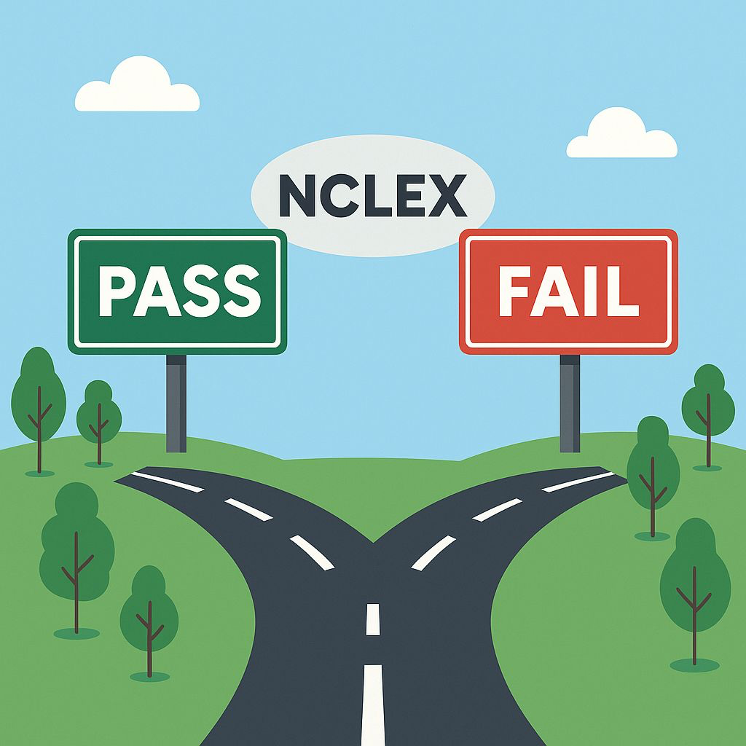
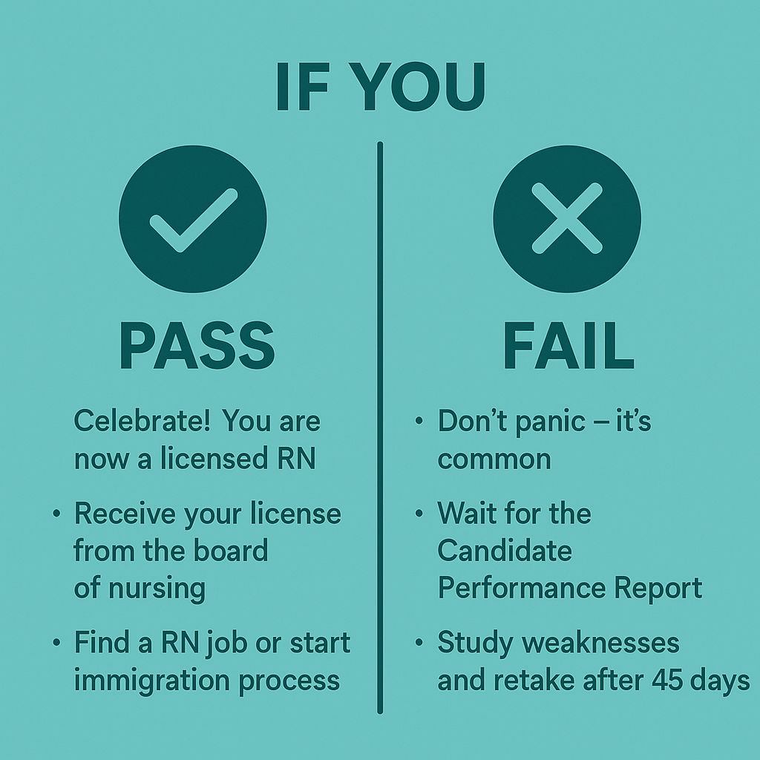
Notes:
Retaking the NCLEX
If you fail, you can retake it after 45 days (varies by state).
You can take it up to 8 times/year.

Slide 12
Fee Breakdown for International RN Applicants
NECLEX Application and exam fees:
Credential Evaluation service (CES) (4 weeks) $400 (R) 150 JOD for GGH (R)
Account with Josph and Silny as Administrator
Application Fee (NMBON) $150 (R)
Fingerprinting / Background Check. $44 (R)
ATT eligibility Pearson VUE (2-3 weeks) $200 (R) 150 JOD for GGH (R)
NCLEX Review Course (Uworld 3 months). $0 150 JOD for GGH (R)
Schedule NCLEX exam 200 JOD for GGH (R)
International test center surcharge $150 (R)
Mailing from Palestine to USA $100 (R)
After Passing the NECLEX:
Immigration Medical exam $300 (You– Refundable)
U.S. Visa interview $325 ( You – Refundable)
English proficiency exam (PTE) $300 (You – Refundable)
Immigration and Licensing fees:
NMBON License Issuance Fee $110 (WWSS)
VisaScreen Certificate $655 (WWSS)
Immigration services $15000 (WWSS)
Relocation:
One way Airfare to the U.S. $800 (WWSS)
Upon arrival the U.S. POCKET MONEY $1000 (WWSS)
3. Up to 3 months accommodation by (WWSS)

Slide 13
🎯Global Gate Mentorship
🩺
🌎
💪
🗣️
Career
Community
Confidence
Continuing Education & Certification
Help with applying for U.S. certifications
(e.g., CCRN, NP, PA, CRNA, DNP)
Cultural Bridge: Share values of compassion, resilience,
and family in the U.S. healthcare system.
Support Circles: Emotional and social support during your
transition to life and work abroad.
Learning Support: Adapt to new
Systems without fear everyone
starts somewhere
Leadership Professional Development
As charge nurse etc
Confidence in Social Settings:
Overcome fear of being judged for
your accent, background, or customs
Understanding U.S. Cultural Norms:
Food & religion , privacy, gender, self help
Choose a workplace that truly values you:
Competitive salary
Sign-on bonuses
Sponsorship for advanced education
Work-life balance
Pension plan
Saving plan
Health insurance

Slide 14

Thank You
Contact Information:
Chief Executive Officer
Dr. Fidaa` S. Ali
+972599440492 OUR OFICESS
ceo@globalgatehealthcare.com
🇺🇸 USA Office
3944, Satsuma lane
Corona CA, 92883, USA
Tel: + 1(714)467-5467
General Manager
Dr.Awni Dweekat
+ 1 9512556278 +972595161964 🇵🇸 Palestine Office
manager@globalgatehealthcare.com Ramallah, Palestine
Manarah Building , 9th Floor,Makani Hub
Tel: +972595161964
Chief Administrative Officer
Mr. Hesham AlSayyad
+1(714)467-5467
cao@globalgatehealthcare.com

